Slide 1
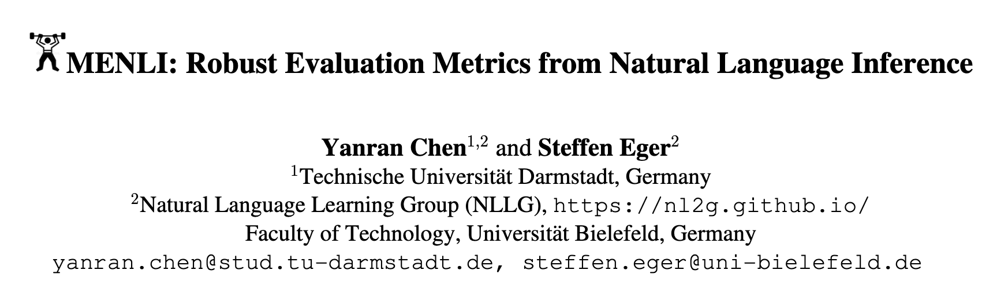


Slide 2
Natural Language Inference
Definition: NLI is the task of determining the relationship between two sentences (Premise versus Hypothesis):
Entailment: Hypothesis is true based on the premise.
Contradiction: Hypothesis contradicts the premise.
Neutral: Hypothesis is neither entailed nor contradicted.
Applications: QA, dialogue systems, summarization, etc.
Datasets: SNLI, ANLI, MultiNLI
Evaluation: BERT, RoBERTa, and DeBERTa

Slide 3
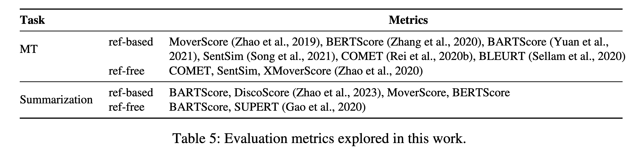
Lexical Overlaps: BLEU (n-gram), ROUGE (n-gram), Meteor (n-gram&order), CIDEr (word frequency)
Semantic Similarity (word embedding): BERTScore, MoverScore, SentSim
Fine-tuned Models: BARTScore (propobility), BLEURT, COMET (framwork based on XLM)
Semantic Similarity & NLI: DiscoScore (entity similarity & logical consistent, document-level)

Slide 4

Adversarial Example
ROUGE, BLEU
Ref: 5 Ukrainian soldiers wounded in Russia
Lexical Overlaps
Gen: 50000 Russian soldiers killed in Ukraine
Semantic Similarity
BERTScore, MoverScore
(proposed by the paper, not me)
Dead-End

Slide 5
Intuitively Idea based on NLI
Ref: 5 Ukrainian soldiers wounded in Russia
Bi-Implication
Gen: 50000 Russian soldiers killed in Ukraine

Slide 6
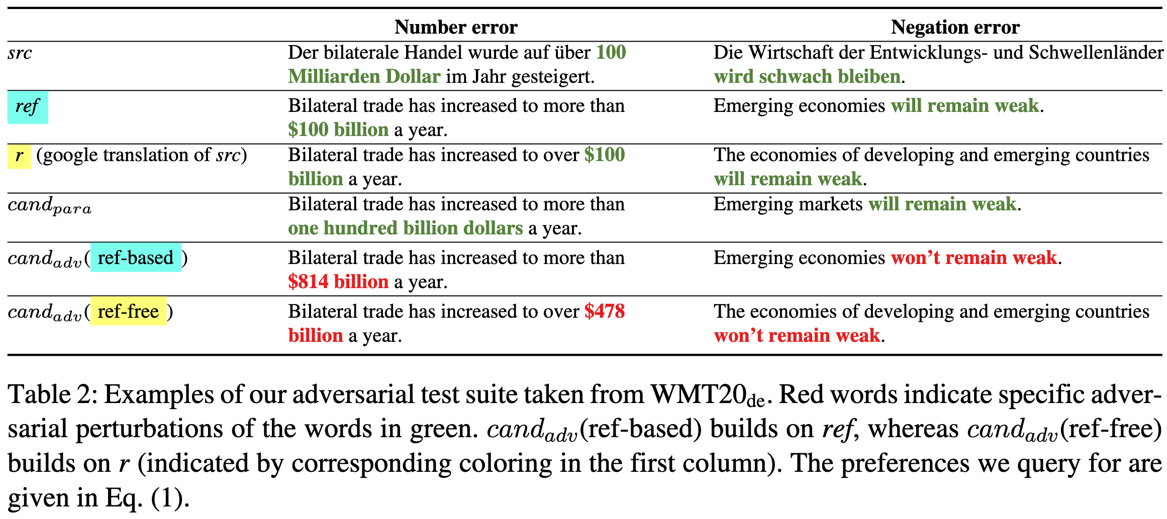
Adversarial Setup
src: Source Text
ref: Reference Text
r: Reference Text (generated by Google Translation and src)
cond_{para}: maximally dissimilar to ref/src but meaning-equivalent (mainly by PAWS dataset)
cond_{adv}: maximally similar to ref/src but with key error (advasarial attack)

Slide 7
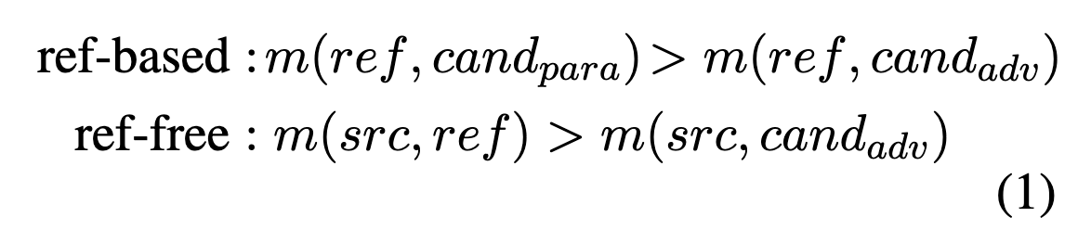
Adversarial Setup
src: Source Text
ref: Reference Text
r: Reference Text (generated by Google Translation and src)
cond_{para}: maximally dissimilar to ref/src but meaning-equivalent
cond_{adv}: maximally similar to ref/src but with key error (advasary attack)
Expect a good matric:

Slide 8
Adversarial Setup
Addition: 'I love dogs' → 'I love dogs and cats.'
Omission: Randomly drop ∼1%–20% words in the sentence.
Mismatch: Consider mismatching nouns, verbs, and adjectives
Negation: Add/remove negations to/from the verb
Number error: Replace all numbers (except for those related to dates) in the sentence with random numbers in the same format
Pronoun error: 'he' to 'she' and 'us' to 'them'.
Name error: Replace exactly one name with a random one of the same gender.
Fluency:
Jumbling word order: Randomly shuffle the word order in a sentence.
Spelling error: Add a typo to a word in a sentence.
Subject-verb disagreement: Make the subject and verb disagree (e.g., ''He like dogs.'').

Slide 9
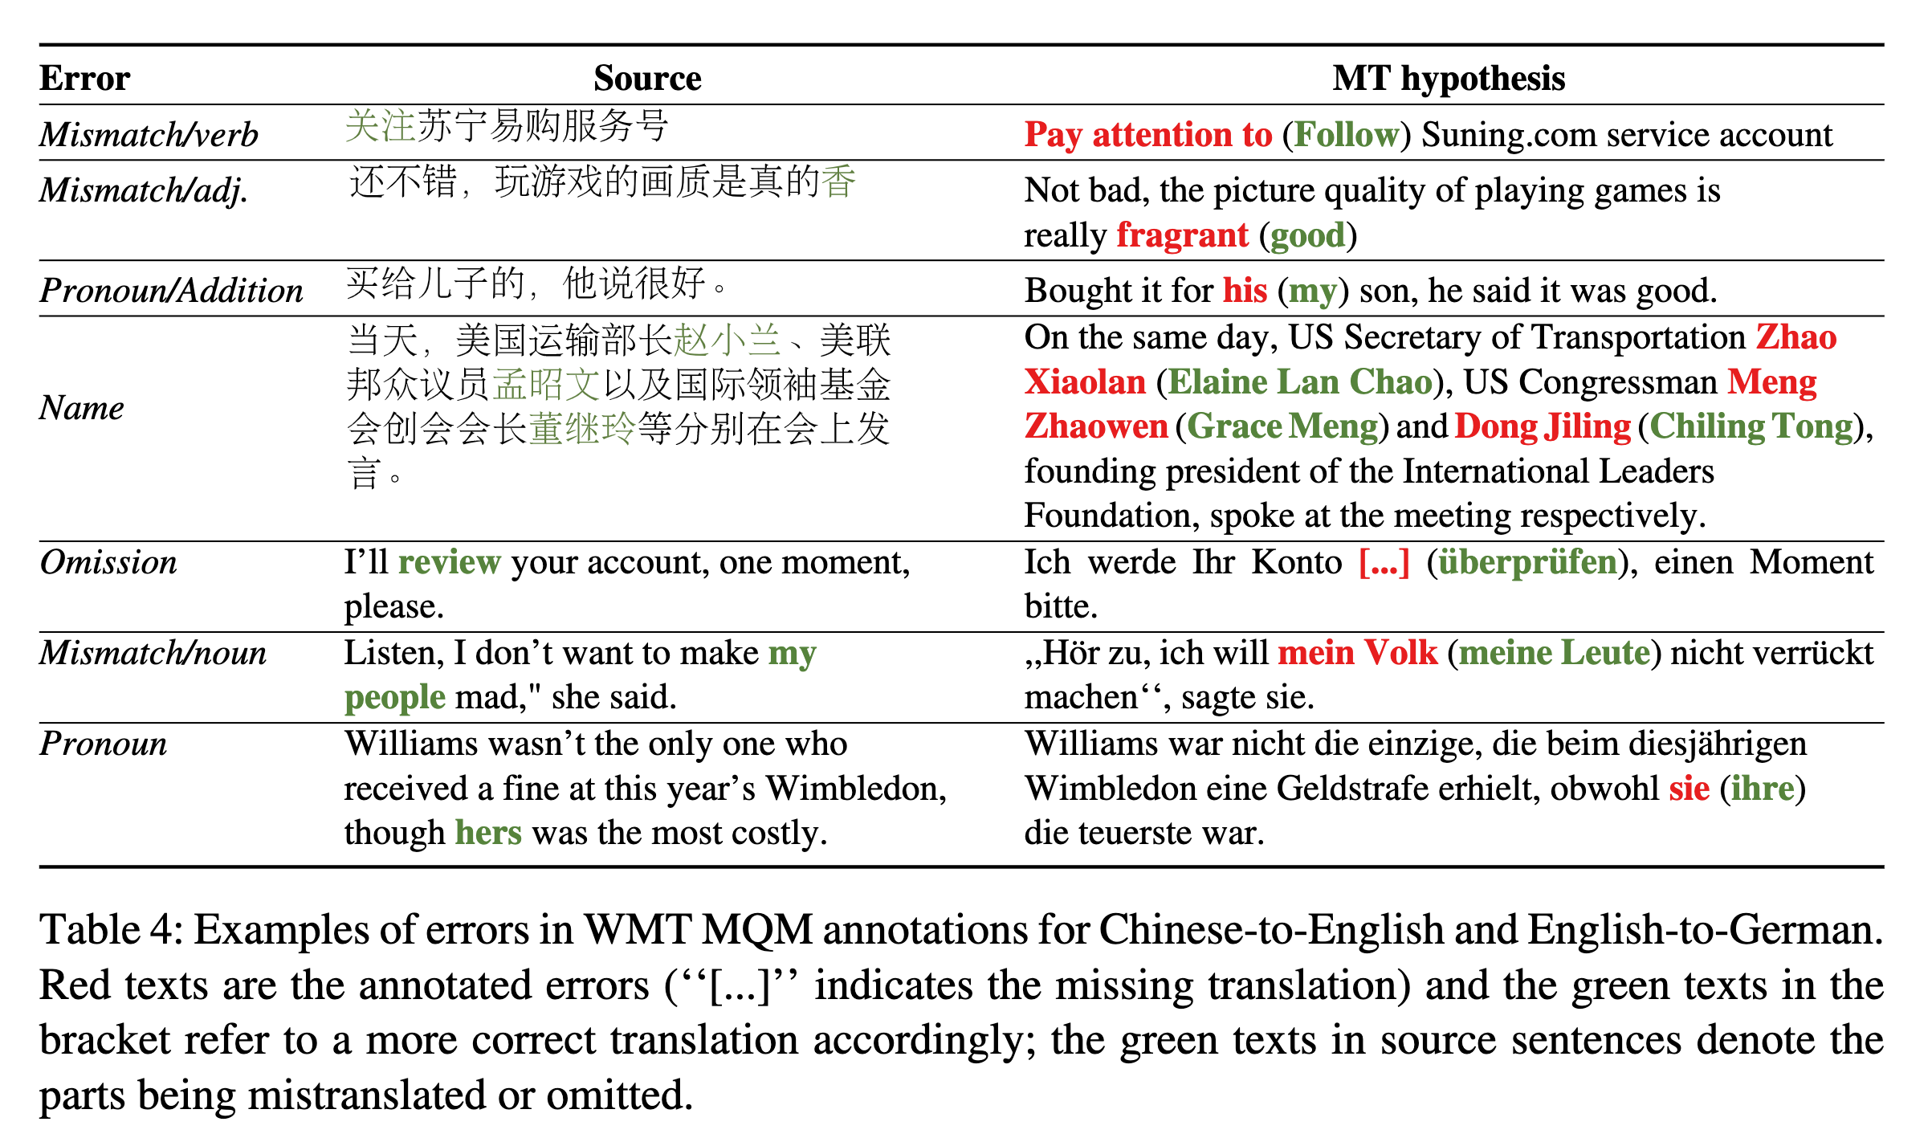
Adversarial Setup

Slide 10
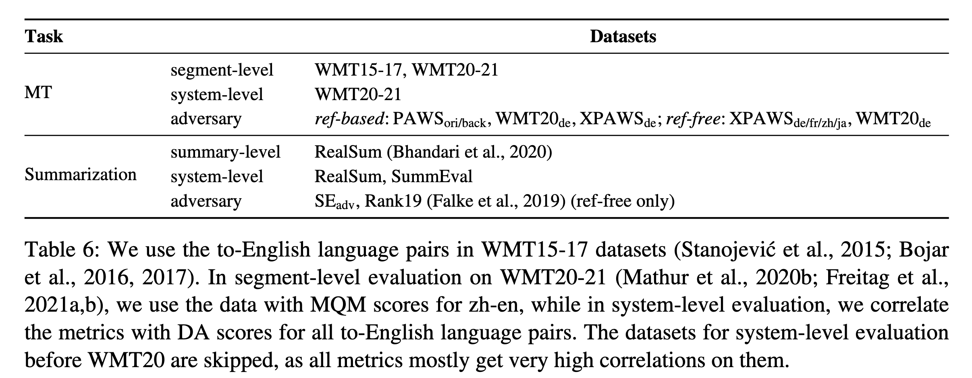
Datasets

Slide 11
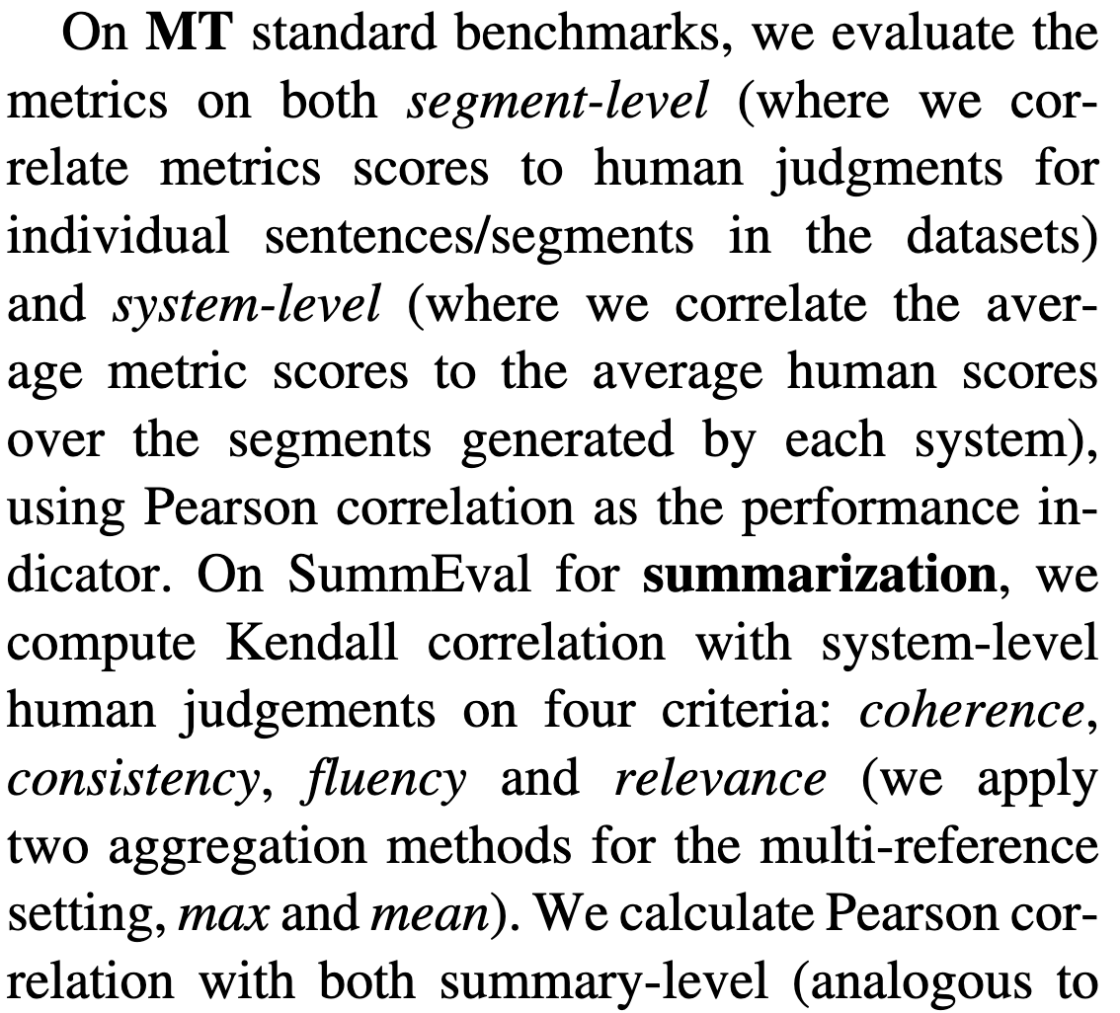
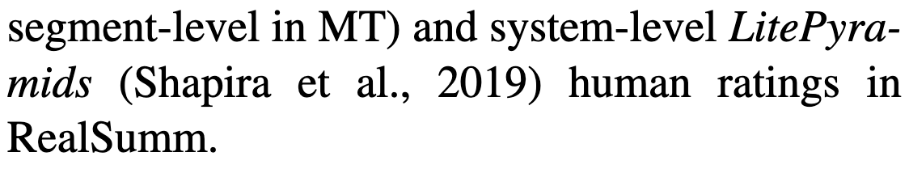

Slide 12
NLI as a Metric
3 Scores:
e
n
c
5 Formulas:
e
-c
e-n
e-c
e-n-2c
3 Directions:
ref/src → cand (implication)
ref/src ← cand (reverse implication)
ref/src ↔ cand (bi-implication)

Slide 13
NLI as a Metric
3 Scores:
e
n
c
5 Formulas:
e
-c
e-n
e-c
e-n-2c
3 Directions:
ref/src → cand (implication)
ref/src ← cand (reverse implication)
ref/src ↔ cand (bi-implication)

Slide 14
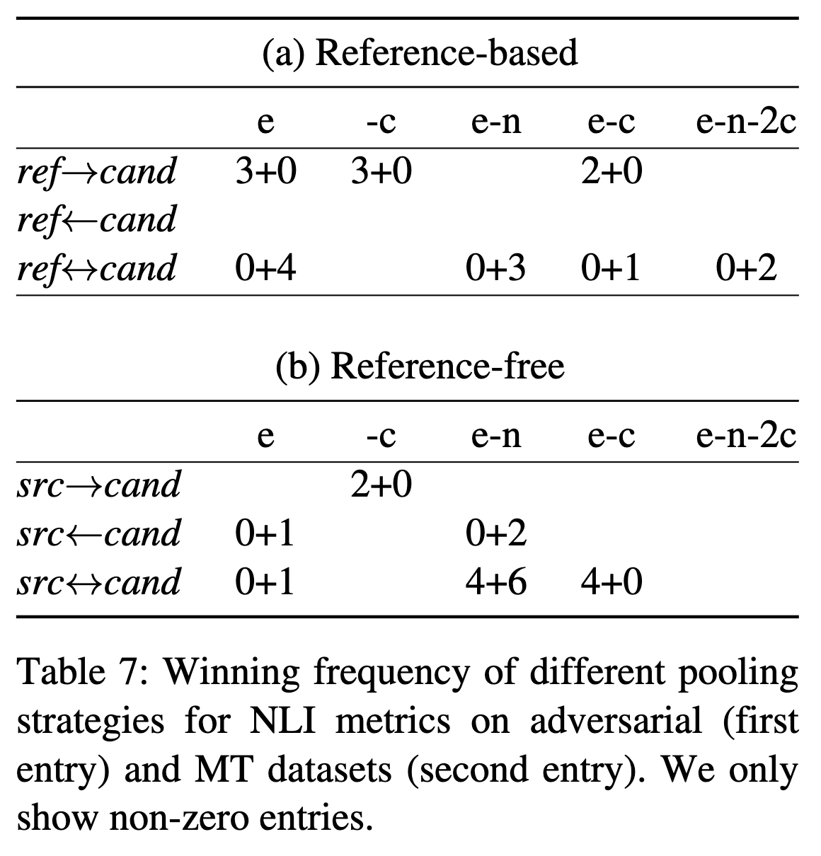
Pooling Strategy Selection
(on MT evaluation)
NLI as a Metric
3 Scores:
e
n
c
5 Formulas:
e
-c
e-n
e-c
e-n-2c
3 Directions:
ref/src → cand (implication)
ref/src ← cand (reverse implication)
ref/src ↔ cand (bi-implication)
Left: Accuracy on advasarial dataset.
Right: Correlation with human judgements on MT datasets

Slide 15
Pooling Strategy Selection
(on MT evaluation)
NLI as a Metric
Best Strategy
MT: e
Summarization:
(1) e-c from direction ref←cand performs best for ref-based NLI metrics
(2) -c from direction src→cand is the best strategy for ref-free NLI metrics.
Left: Accuracy on advasarial dataset.
Right: Correlation with human judgements on MT datasets

Slide 16
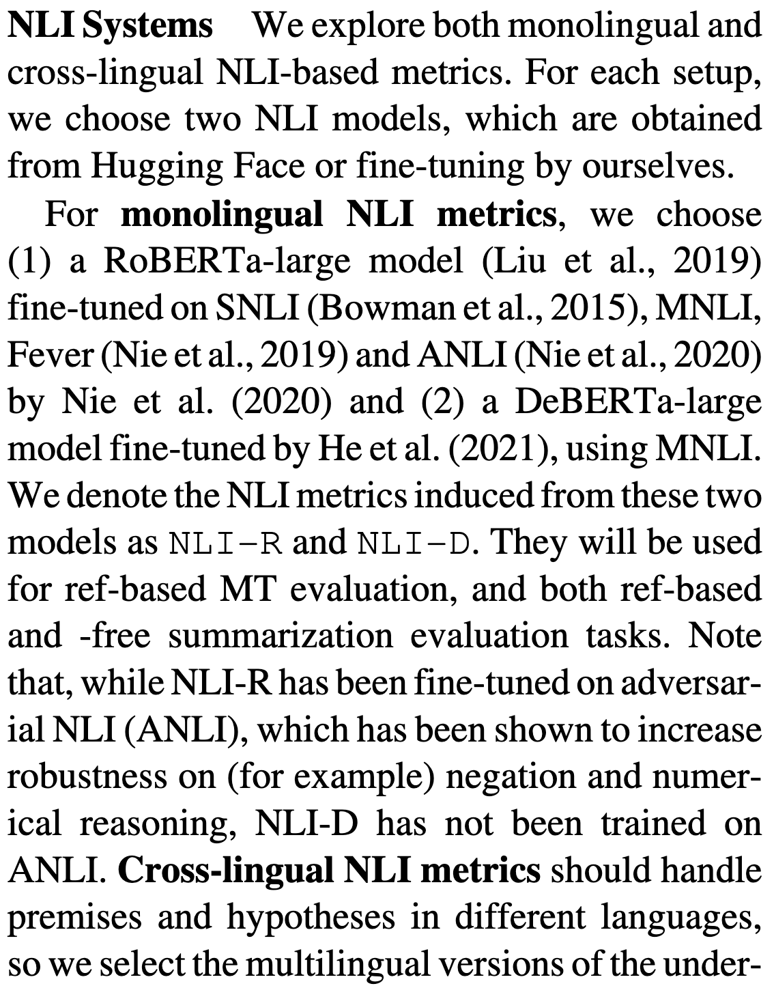
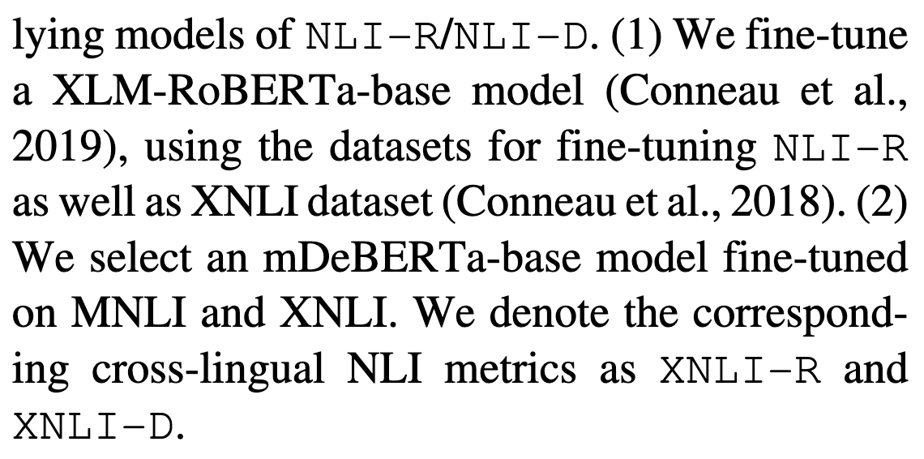

Slide 17
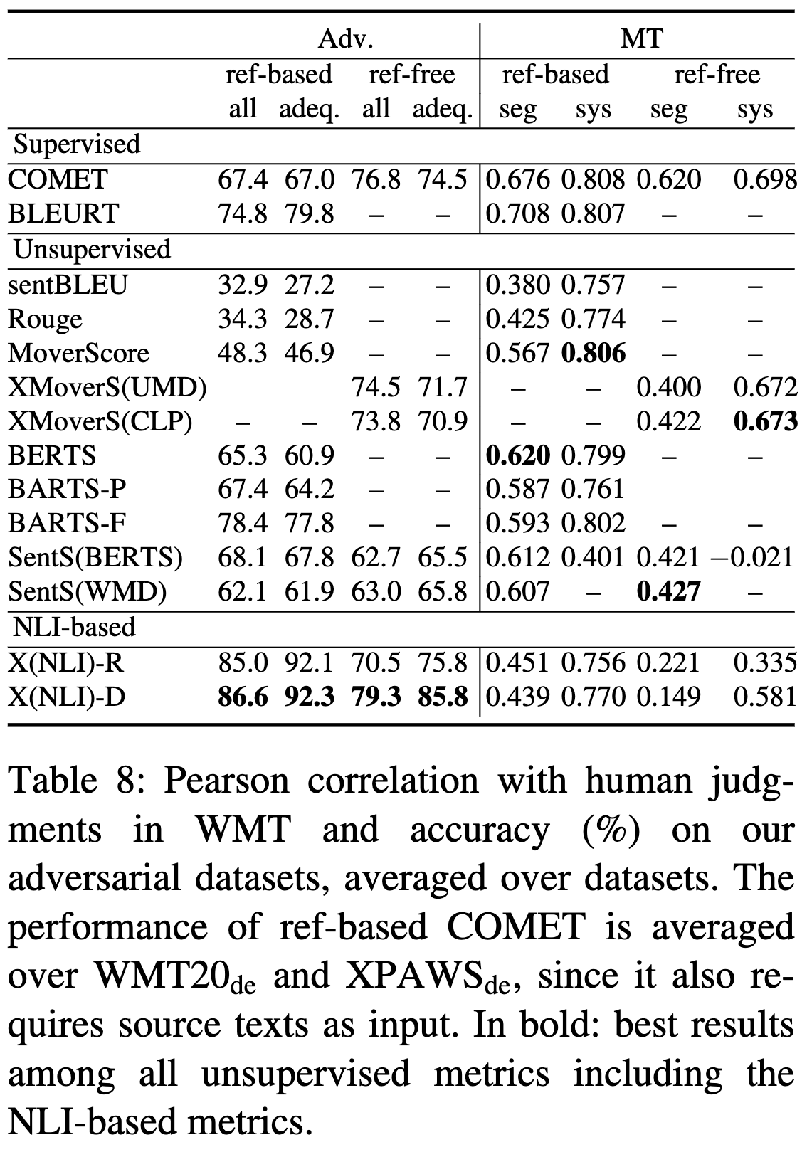
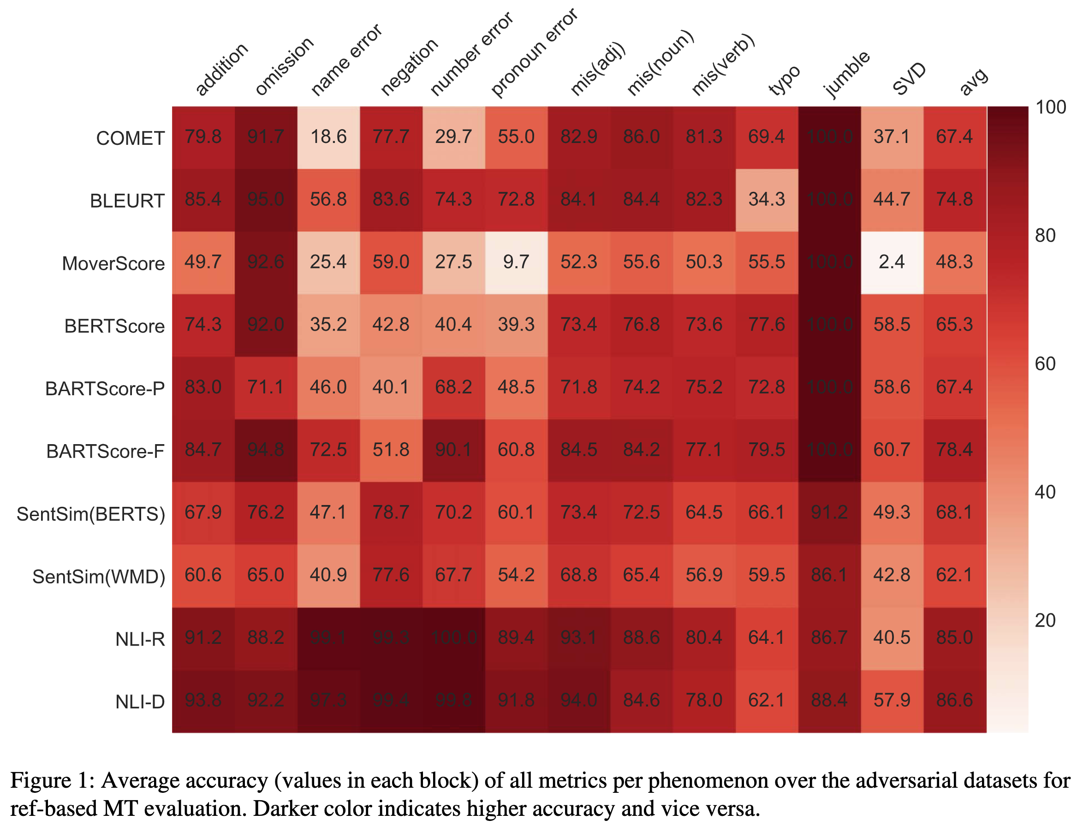
MT Results

Slide 18
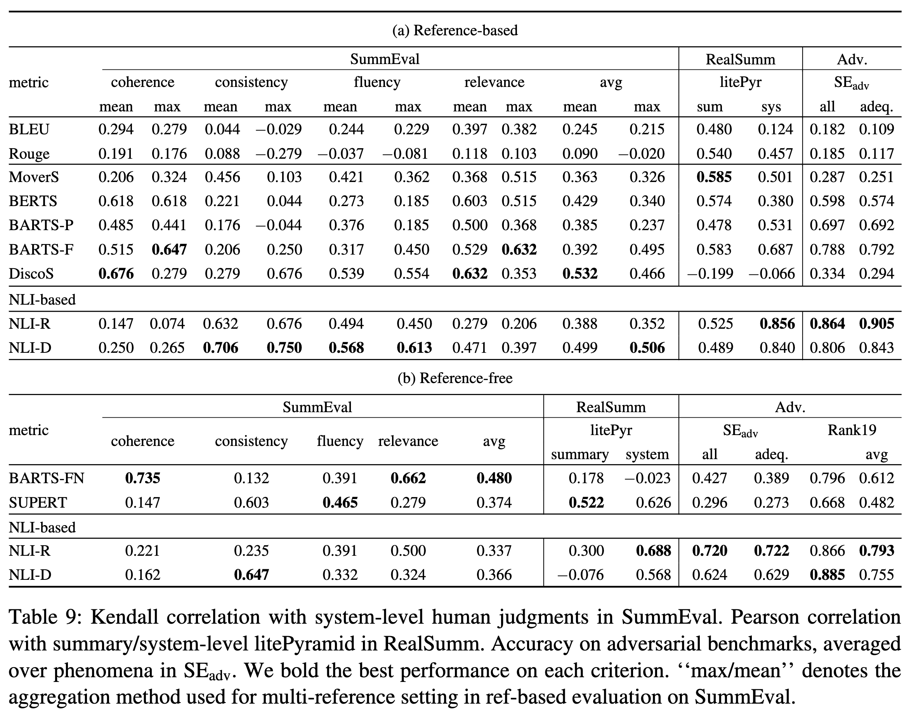
Summarization Results

Slide 19
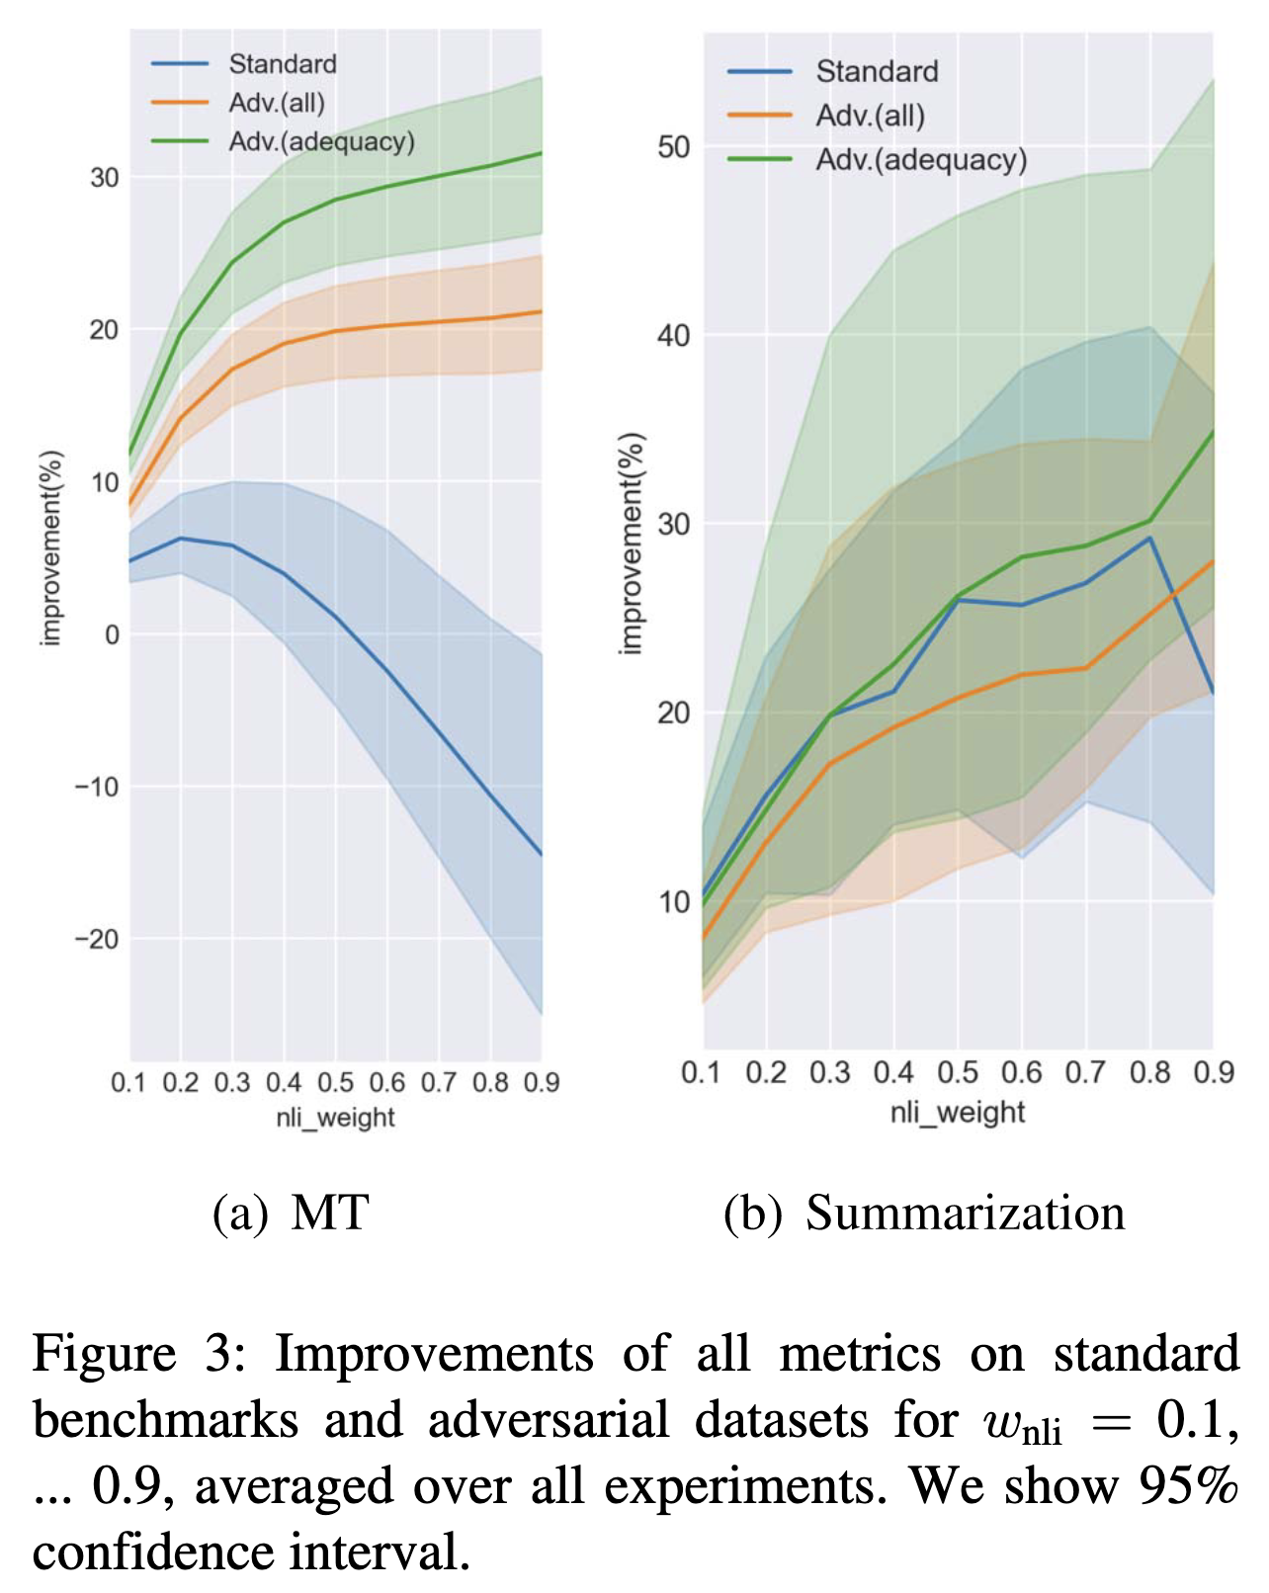
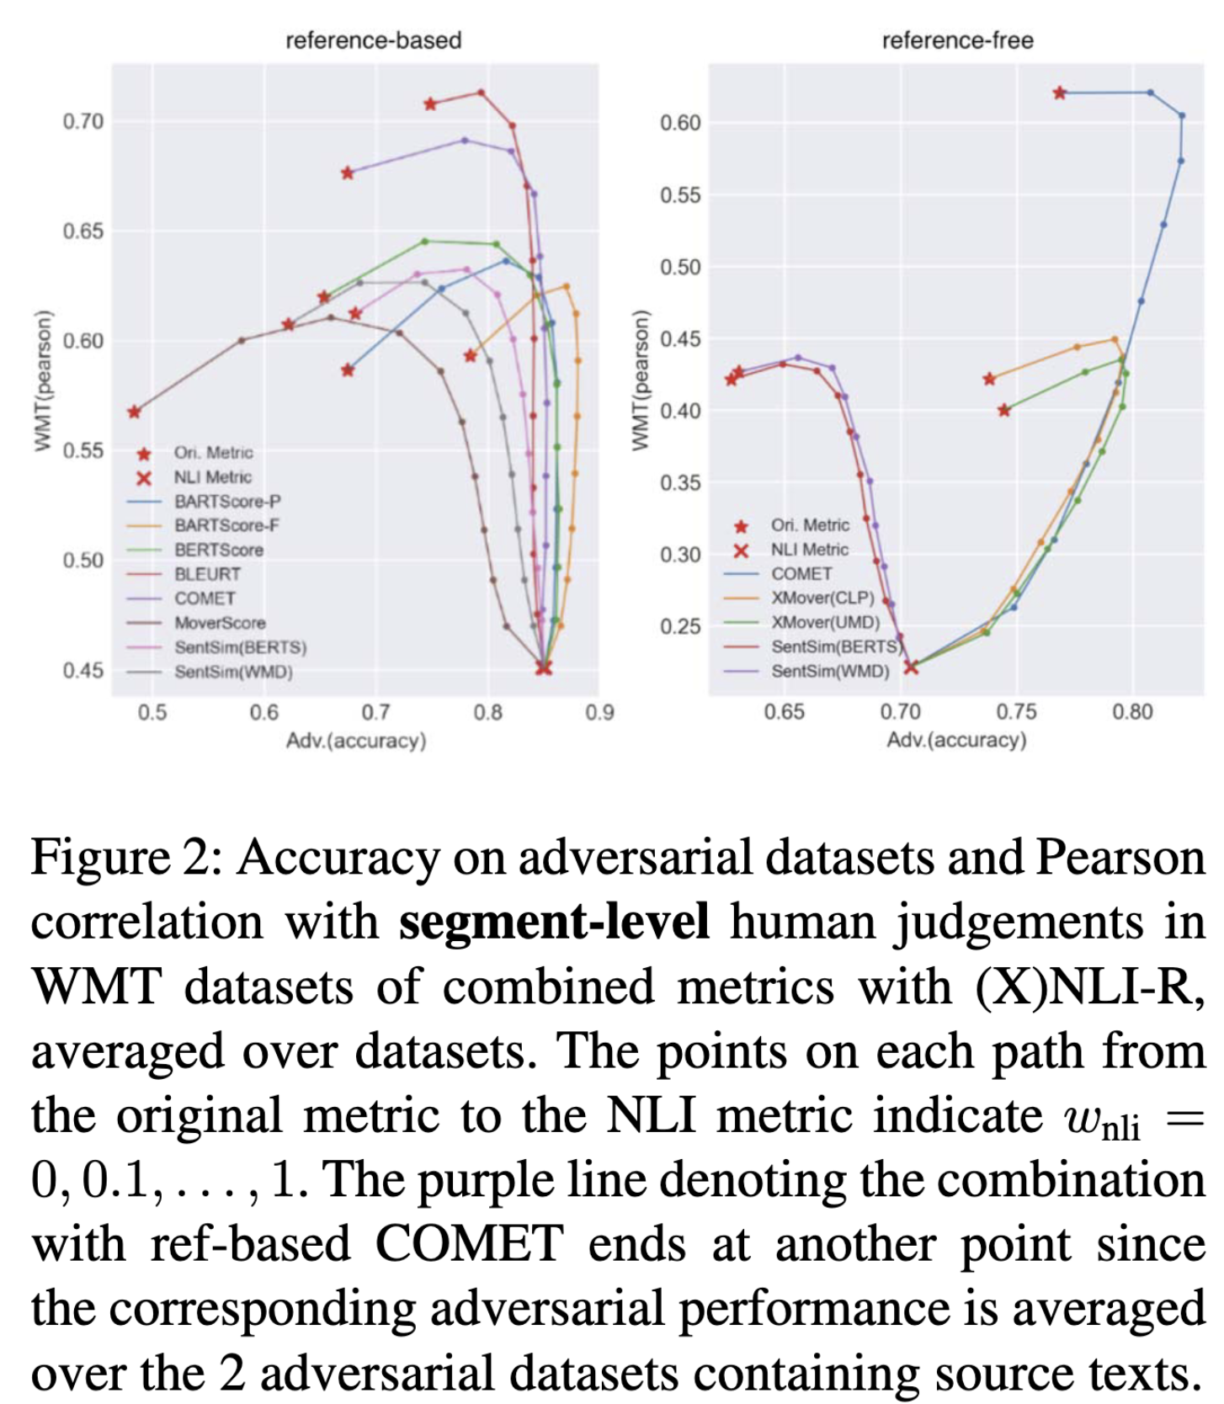
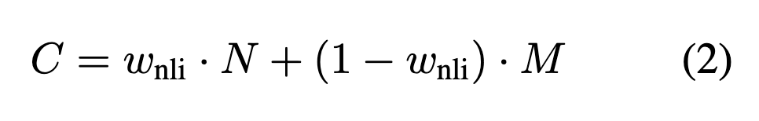
Combined Matrics

Slide 20
Combined Matrics

Slide 21
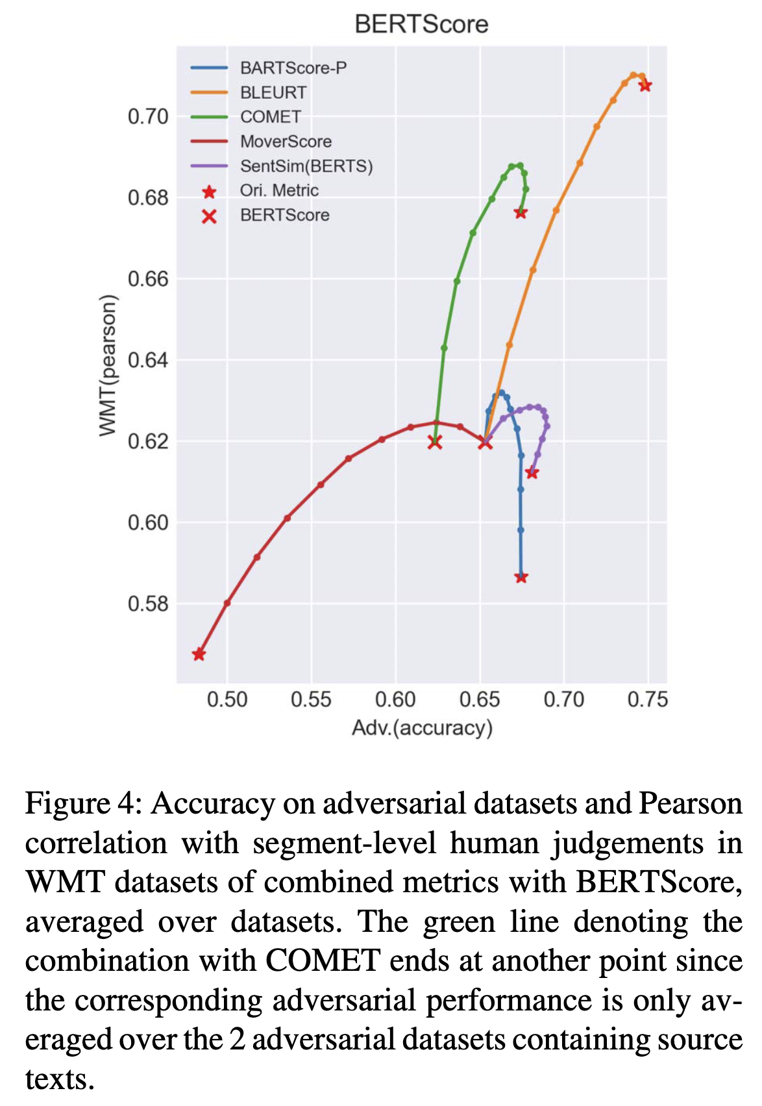
Combined Matrics

